Slide 1


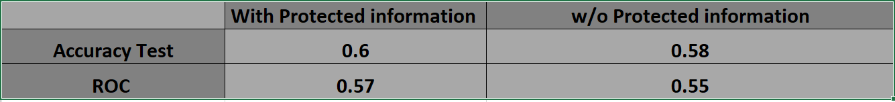
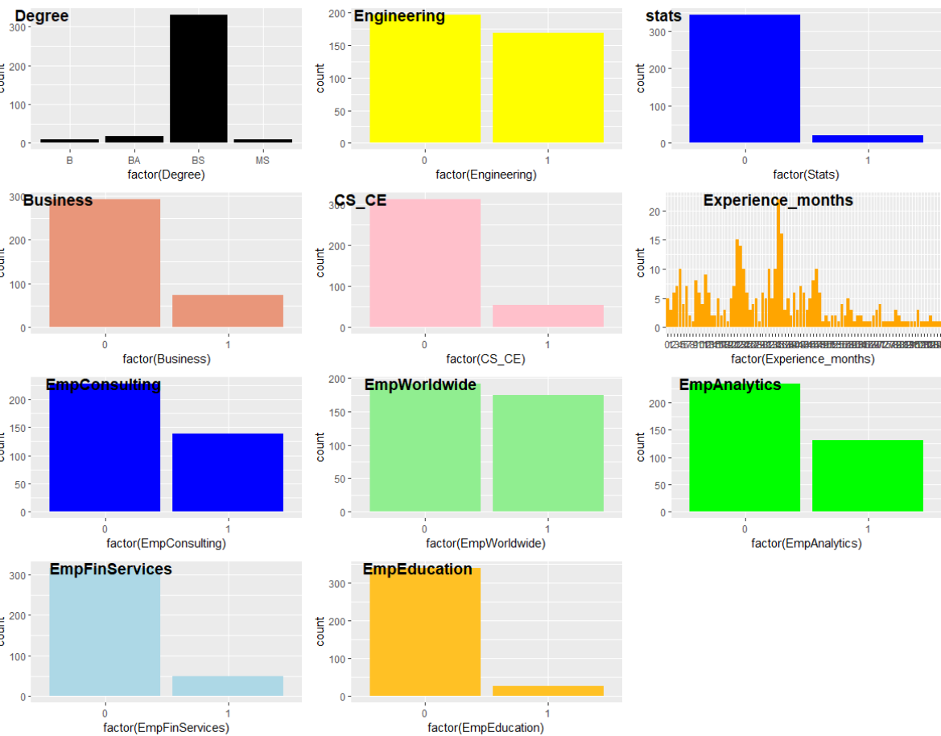
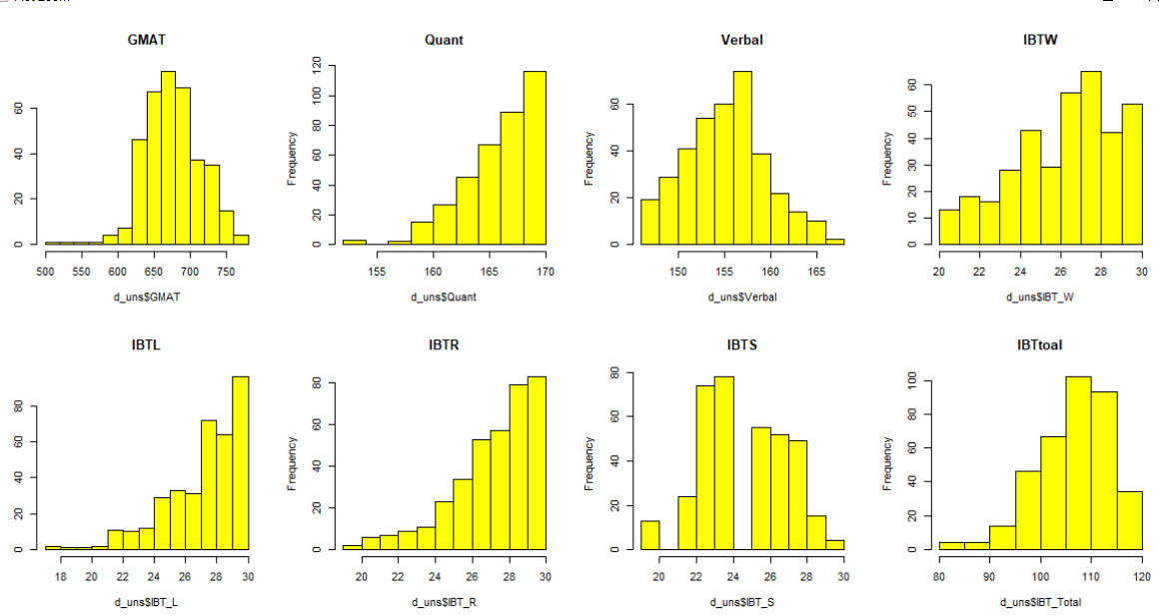
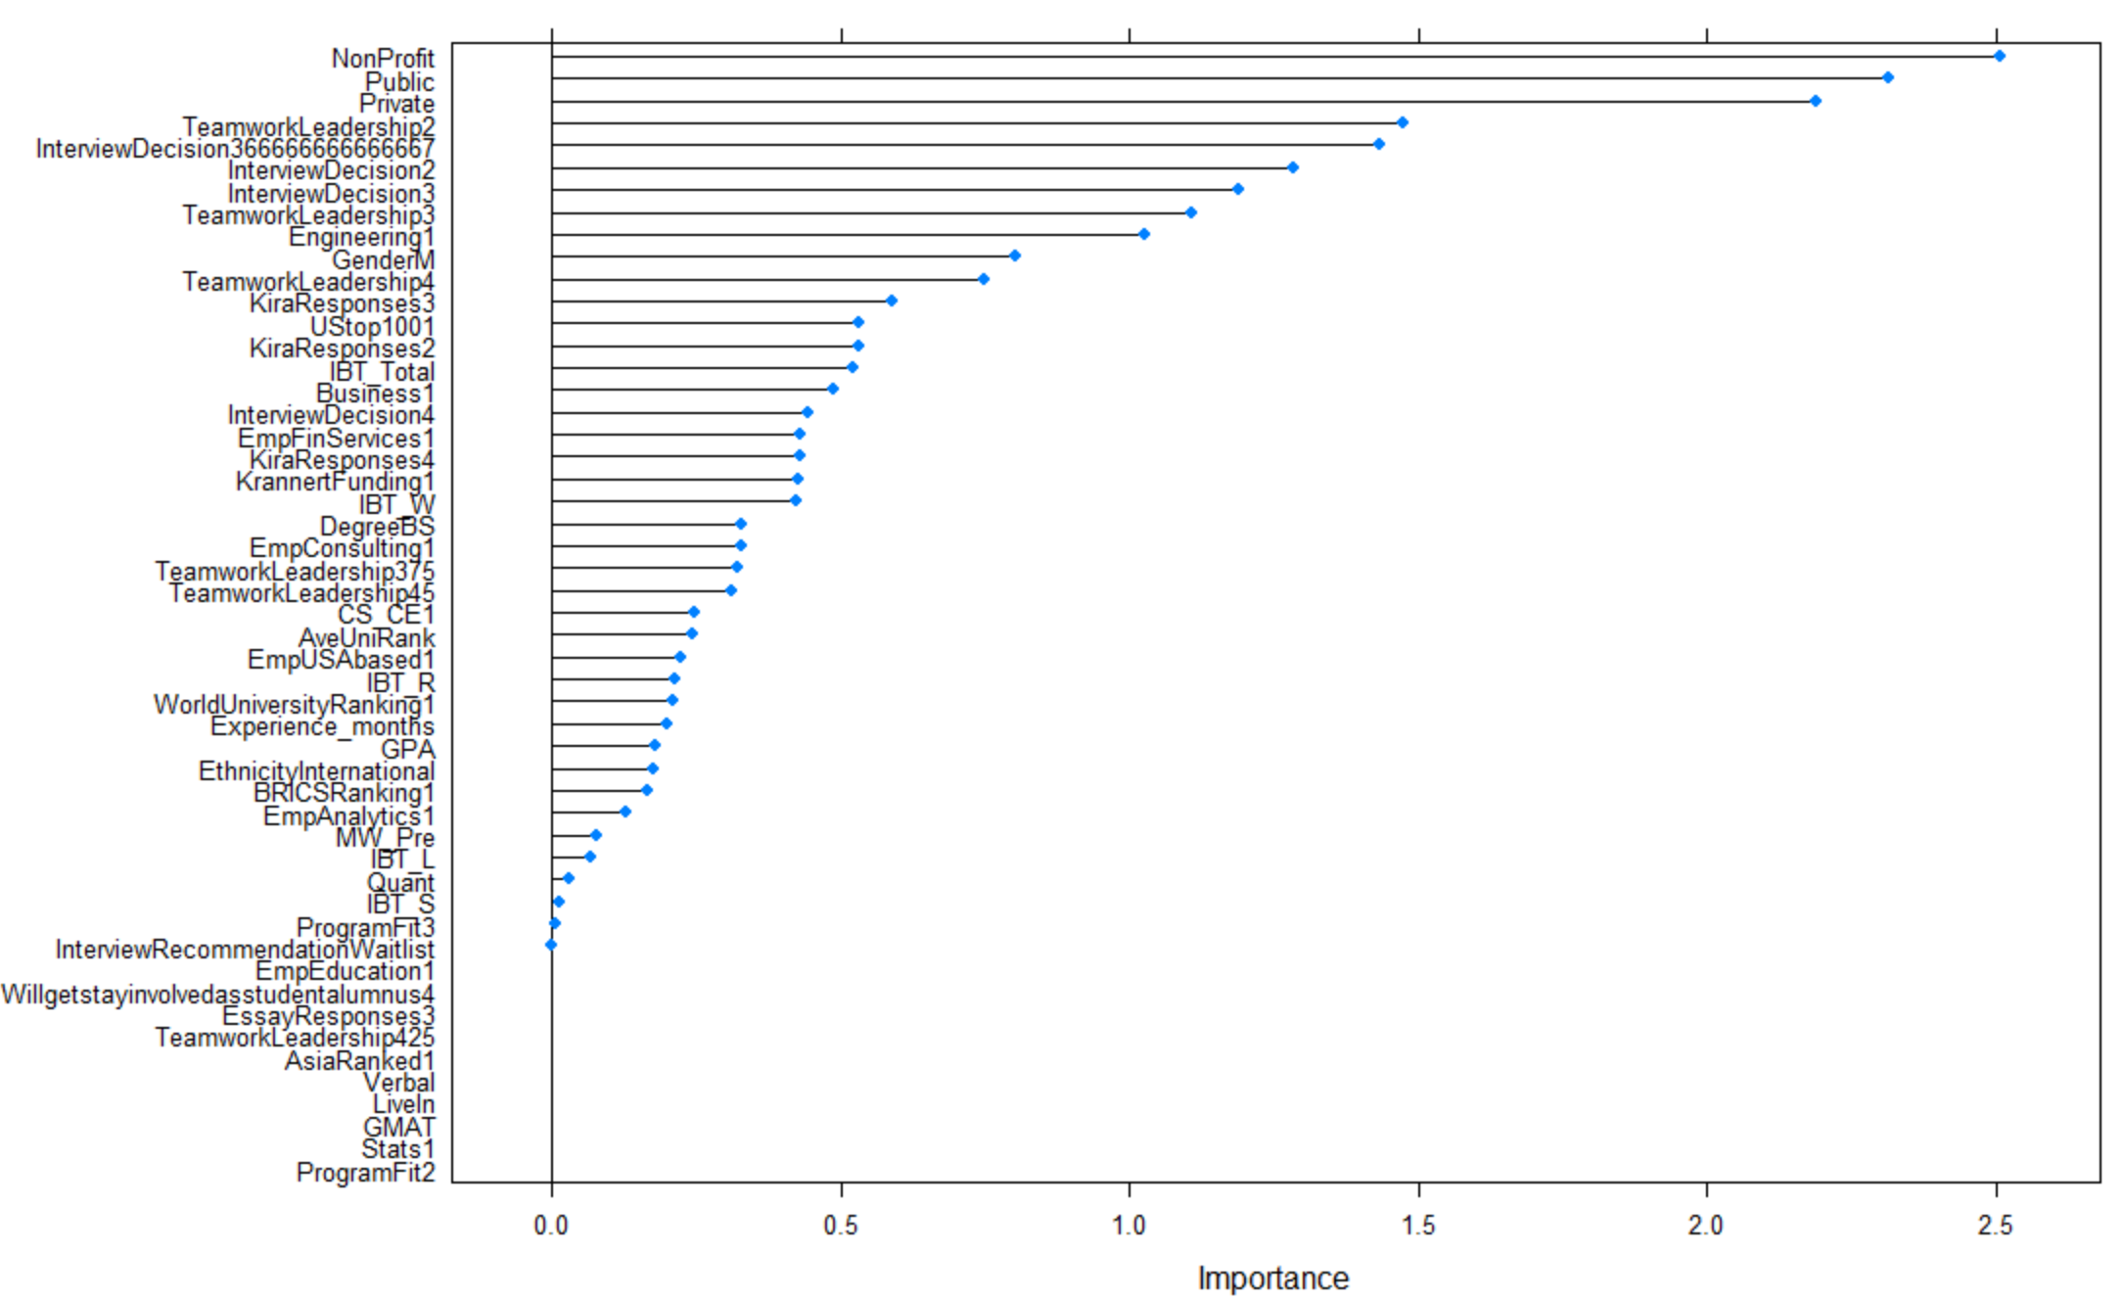
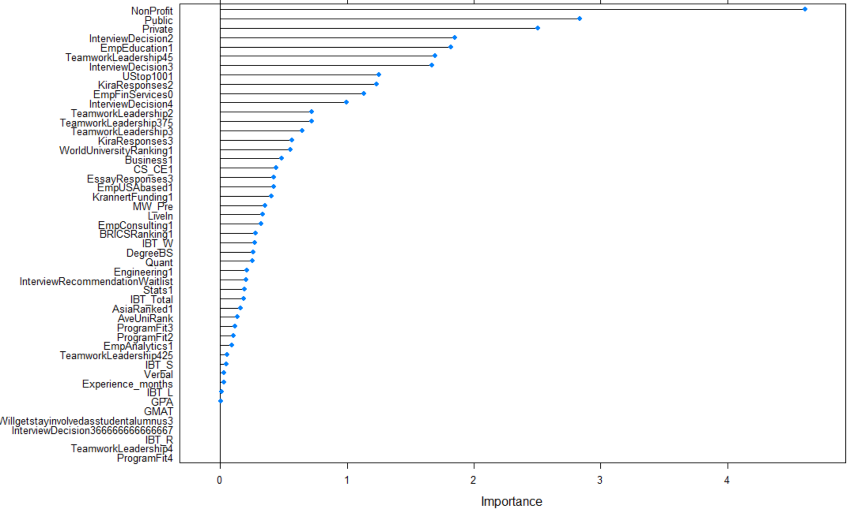

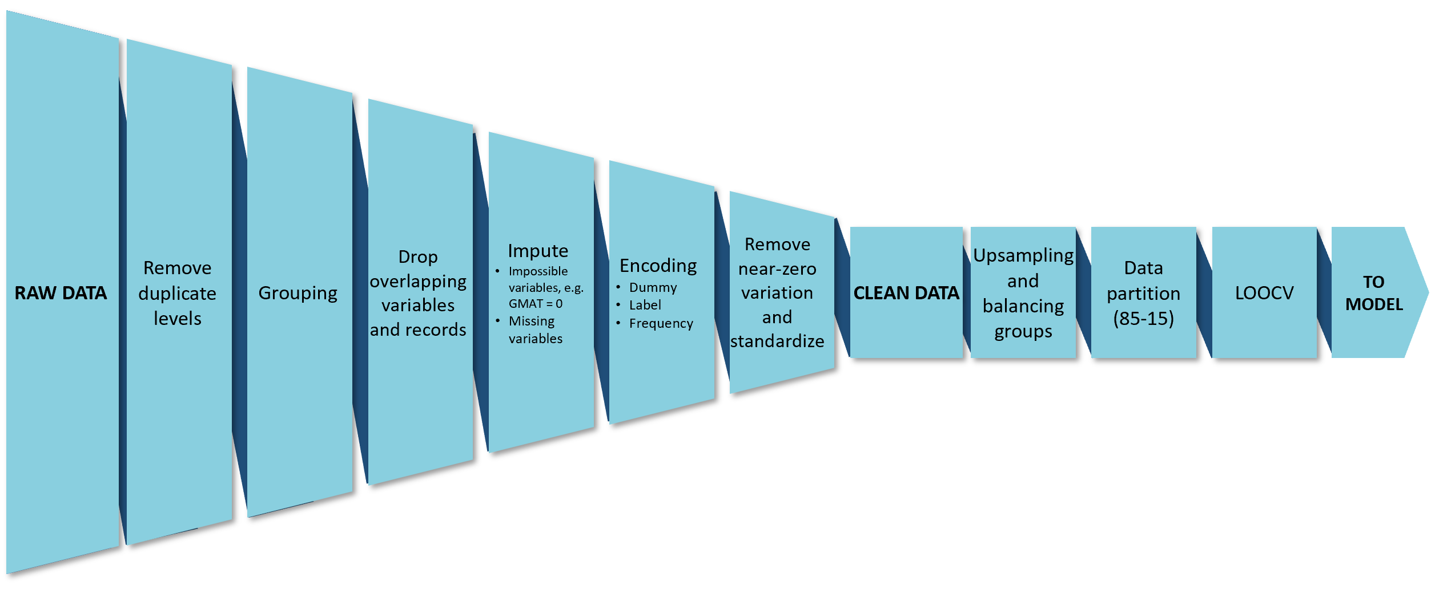



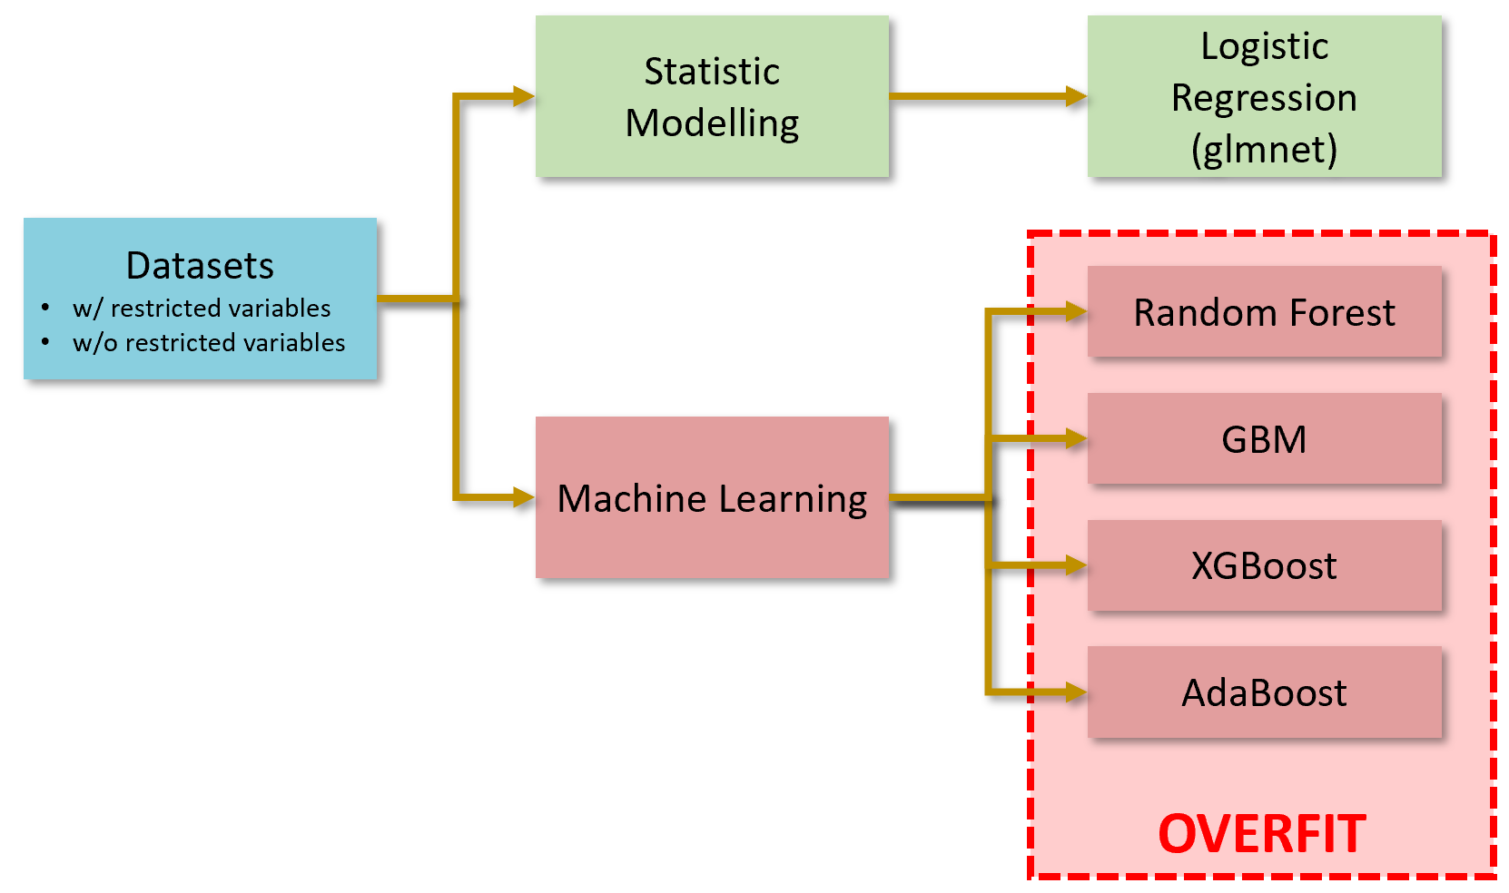
Study
Xuan Dong, Xuanming Hu, Iscel Manalo, Lindsay Neufer, Matthew A. Lanham
Purdue University Krannert School of Management
dong258@purdue.edu; hu661@purdue.edu; manalo@purdue.edu; lneufer@purdue.edu; lanhamm@purdue.edu
Methodology
Abstract
we consider is X because…
Data
The dataset is from the MS BAIM program applicants' information from classes starting from 2016 to 2018. It consists of 373 rows and 76 variables covering different applicant attributes describing their personal information, educational and professional background, assessment scores, and recruiter evaluation.
Data Processing
A second dataset was also created that excluded variables for protected classes i.e. gender, age, ethnicity.
Models
Results
Program enrolment is critical for the growth of the MS BAIM program. To ensure growth, the program has been keeping track of the information of the candidates who accepted or declined their offers. This data is used to create a predictive model of whether a candidate of a certain profile have a high chance of accepting the offer. This will guide the program in sending out enough acceptance offers to make certain that they can fill the program capacity and maximize revenue. Intensive preprocessing procedures were performed to increase consistency and usability of the data. Logistic regression was used primarily to create a model with the other models resulting in overfitting. This could be attributed to data quality which can be improved for future research and analysis.
Important drivers : Teamwork_leadership, InterviewDecision, Nonprofit, Public, Private
Students with strong leadership will intend to accept the offer.
Students who feel comfortable in the interview will intend to accept the offer.
Students who worked on nonprofit project will intend to accept the offer.
Type of school students attended for their past professional study is also a important driver.
Figure 4. glmnet results
Introduction
Figure 5. Variable importance graph (left: w/ protected information; right: w/o protected information)
The Krannert School of Business aims to improve its admission process for the MS Business Analytics and Information Management (MS BAIM) program. One of the common challenges is program candidates declining their admission offers or reneging after accepting their offers ("melting") .
This poses a challenge that impacts both program attendance and its ability to generate revenue.
To better improve the admission process, the department must be able to identify high potential candidates who are at risk of declining offers or melting. Preemptive measures can then be made to reduce those risks by offering competitive funding and counter other factors keeping them from enrolling in the program.
Attributes pertaining to protected classes were also considered during the analysis. Protected classes are factors, often used in employment, that can be grounds for discrimination if found to be a determining factor in the selection processes.
Research Questions:
• How do we recognize candidate profiles with higher risk of declining offers?
• Which candidate attributes(s) have the highest influence (positive and negative) on offer acceptance?
Figure 1. Exploratory data analysis
Conclusion
The resulting model provided a moderate accuracy which makes it not as reliable to be used as determinant on whether candidates will accept the offers. The dataset, however, was able to provide some attributes that can have the highest impact on a candidate's decision whether or not they will accept their offers. We were also able to show the change in accuracy and ROC of the model as a result of removing the protected information in the analysis.
Some challenges that the project encountered was the limited data size. This, along with the raw data being "dirty" could have caused some of the machine learning models to overfit. There were also a lot of inconsistencies in the way data is collected and coded over the years, especially for qualitative information.
Figure 2. Data processing steps
Recommendations
An improvement for future analysis is indicating in the dataset whether a candidate backed out after accepting their offer in addition to their admission acceptance. A separate variable as to what stage of the admission process they backed out can also provide additional insights into candidate behaviors. These additional variables can be used for analysis focusing on reducing “melting” in the admission process.
Additional information is also necessary for the model to fully serve its purpose to the MS BAIM program. Insights provided by candidates can be collected through surveys and added to the variables used in the analysis. This could include information such as their reasons for accepting or rejecting their offer. Knowing which of these factors have the highest impact could help Krannert counter or reinforce those forces and ensure high enrolment rate into the program.
Figure 3

